Slide 1
Sprint 3
Team 4!!
Joel, John, Nick, Diego, Chris

Slide 2
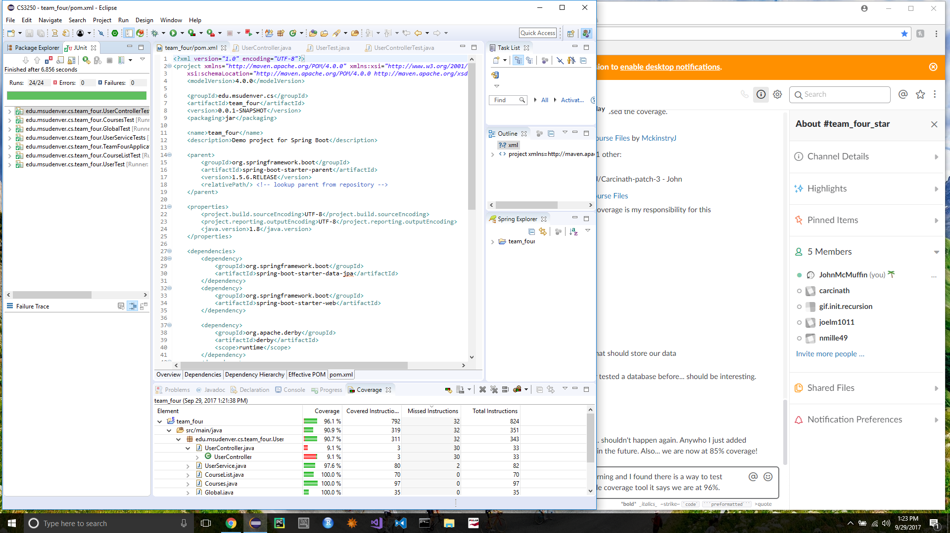
Junit Test Coverage in Eclipse

Slide 3
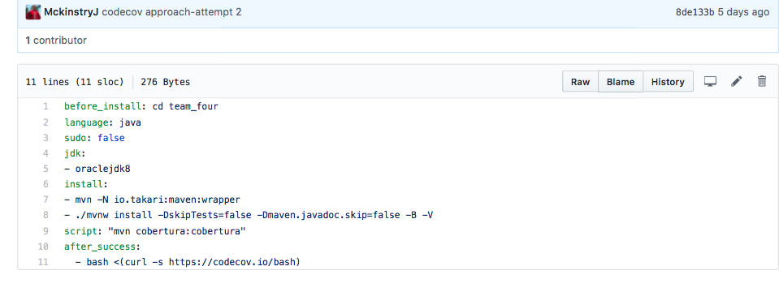
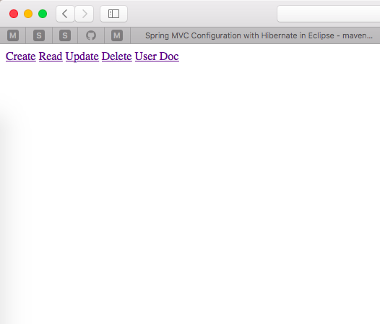
Travis-Ci

Slide 4
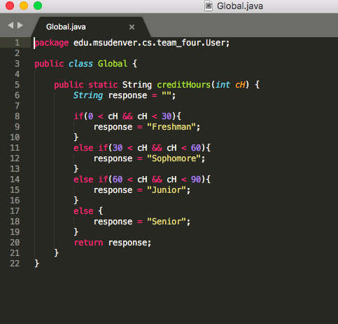
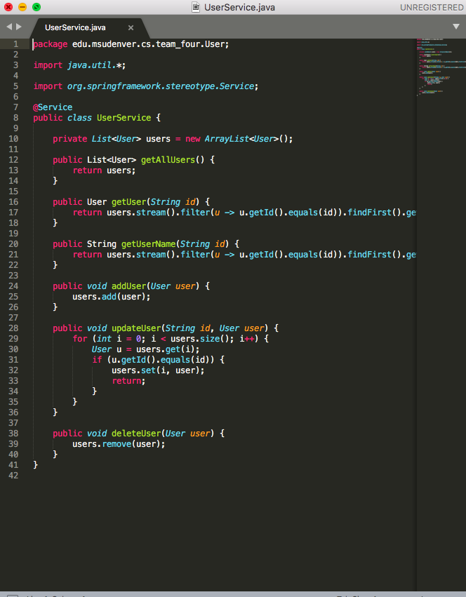
Added Classes With Separate Test Classes

Slide 5
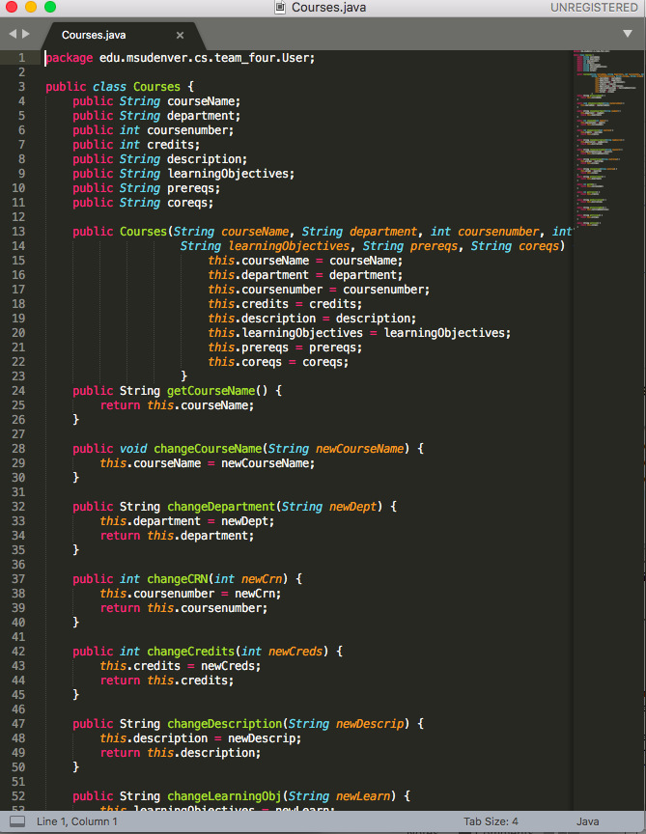
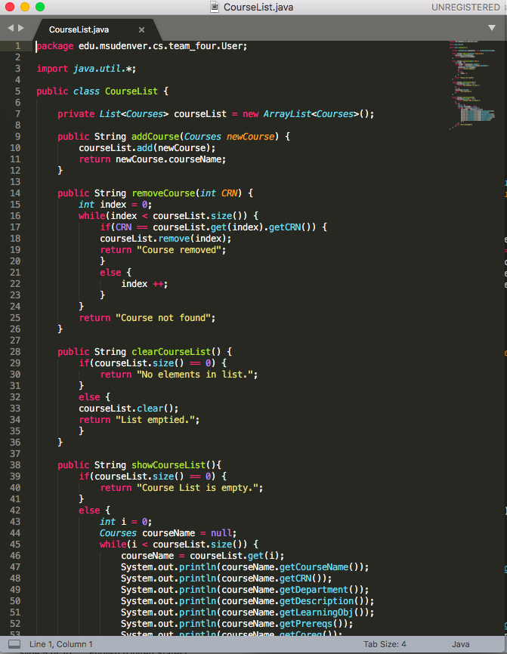
Added Classes With Separate Test Classes

Slide 6
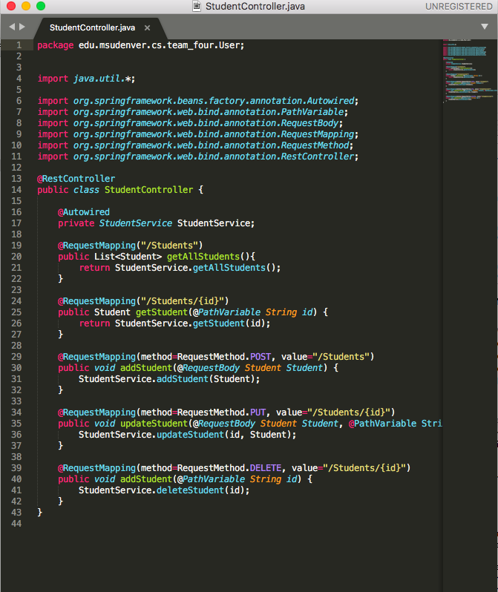
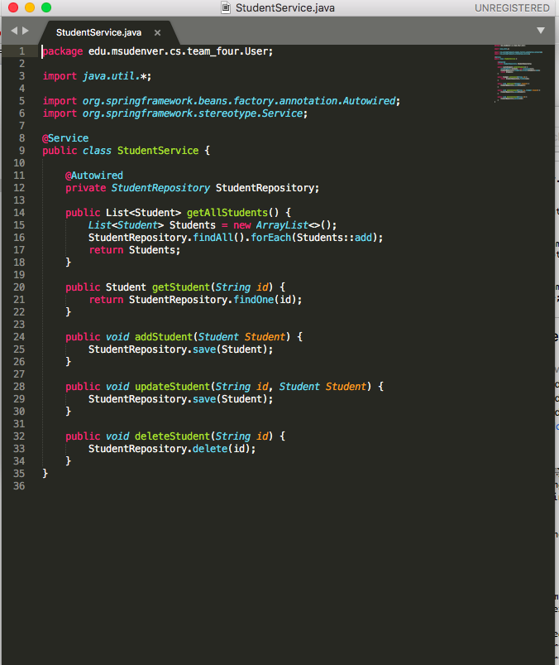
Added Classes With Separate Test Classes

Slide 7
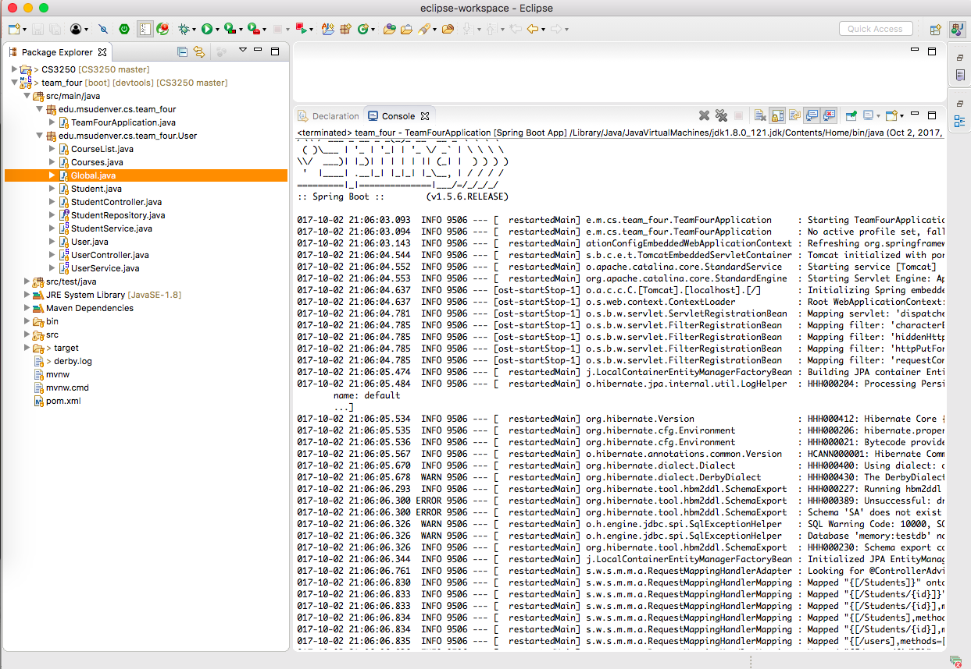
Run Spring Boot App.

Slide 8
Retrospective
What went well:
Some group members did majority of the workload just to get tasks finished for this sprint.
What did not go well:
Contribution throughout the group was lopsided and unfair to other group members
What needs to change:
Timing and completions of tasks by group members that did not contribute.

